Slide 1

SOK: Side Channel Monitoring for Additive Manufacturing – Bridging Cybersecurity and Quality Assurance Communities
Muhammad Ahsan, Muhammad Haris Rais, Irfan Ahmed
Virginia Commonwealth University, Richmond, USA

Slide 2
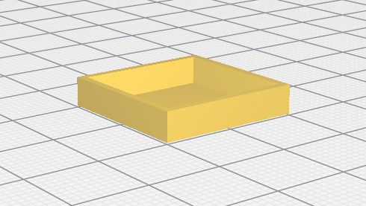

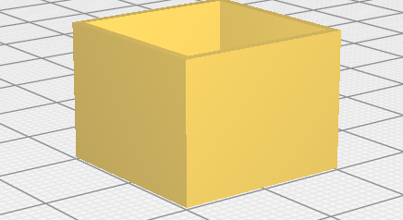
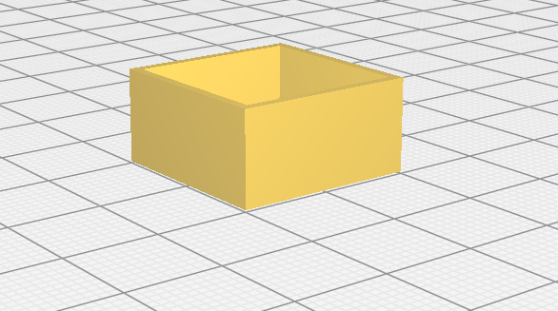
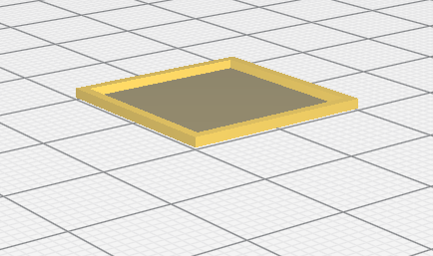
Fused Filament Fabrication
Fused Filament Fabrication is a type of Additive Manufacturing
A material extrusion-based process
Extruding a heated filament through a heated nozzle and depositing layer by layer to create a 3D object.
CAD software
Creating a CAD File
Designing
STL Editor Software
CAD to STL File
Slicing
Slicer Software
G-codes from STL file
Printing
3D printer firmware
Printing the object

Slide 3
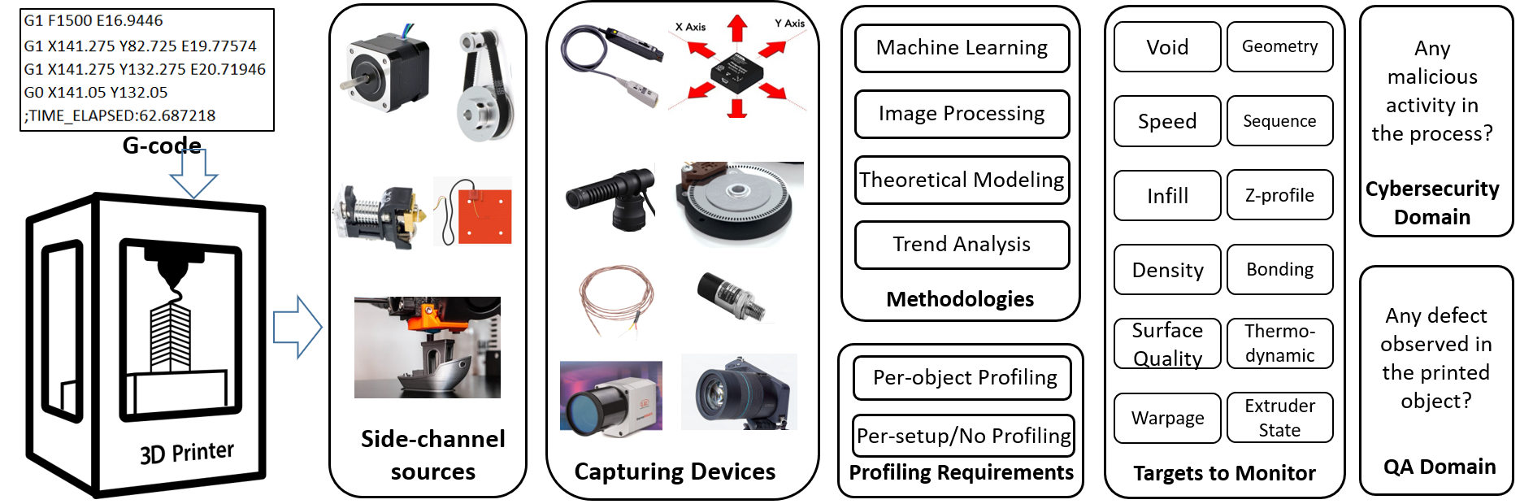
Systematization Methodology

Slide 4
Side Channel
Acoustics | Electric Current
Thermal | Optical
Laser | Pressure
Vibration | Heterogeneous Sensors
It refers to physical domain data that is being leaked from the AM process.
Monitoring and Detection techniques uses Side Channels.
Total of 8 Side Channels are extensively researched in literature.

Slide 5
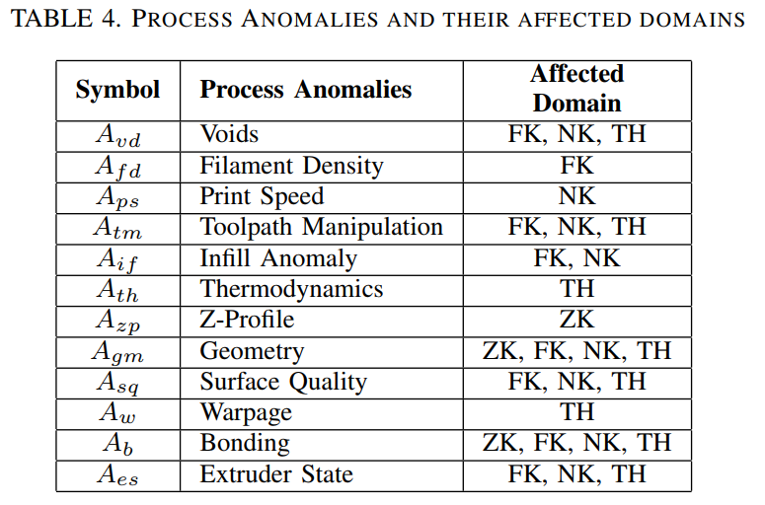
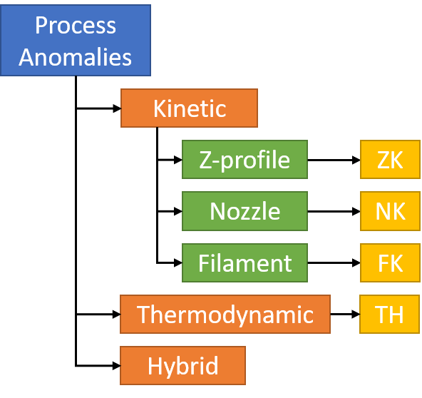
Process Anomalies
These are the potential anomalies/defects that are being monitored using Side Channels.
Three types
  Kinetic
  Thermodynamic
  Hybrid
12 process anomalies

Slide 6
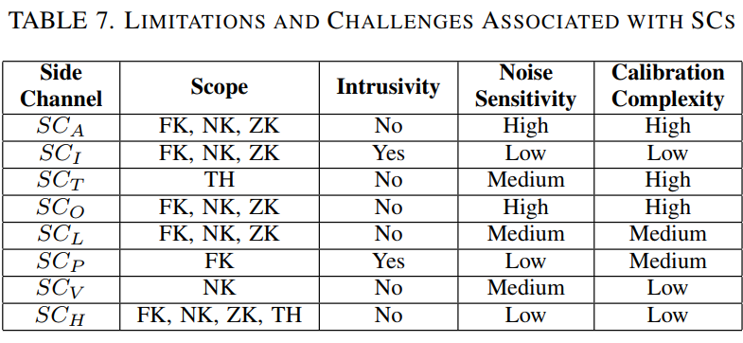
Side Channel Limitations and Challenges
Intrinsic limitation associated with each Side Channel
  Scope -> defines physical domain (Kinetic, Thermal)
  Intrusiveness
  Noise Sensitivity
  Calibration Complexity

Slide 7
Research Challenges
Industry 4.0 -> per setup profile training.
Self correcting close Loop monitoring system.
Detection of low magnitude and low footprint attacks.

Slide 8
Future Recommendations
Use Case Specific Design of Monitoring System.
Inbuilt Security Solutions
Benchmarking Monitoring Techniques

Slide 9
Conclusion - QA vs Security
QA monitoring is quality focused
QA focused on printed part
QA used for optimizing printing parameters
QA monitoring systems has low precision
QA covers broader set of anomalies
One process anomaly at a time
Security is deception focused.
Security focus on detecting malicious modification in process.
Security focuses on printing process integrity
Security systems are more accurate and precise in detecting anomalies
Covers most of the detection surface

Slide 10

Thank you!!
Questions?
Contact Information: ahsanm5@vcu.edu

